Slide 1
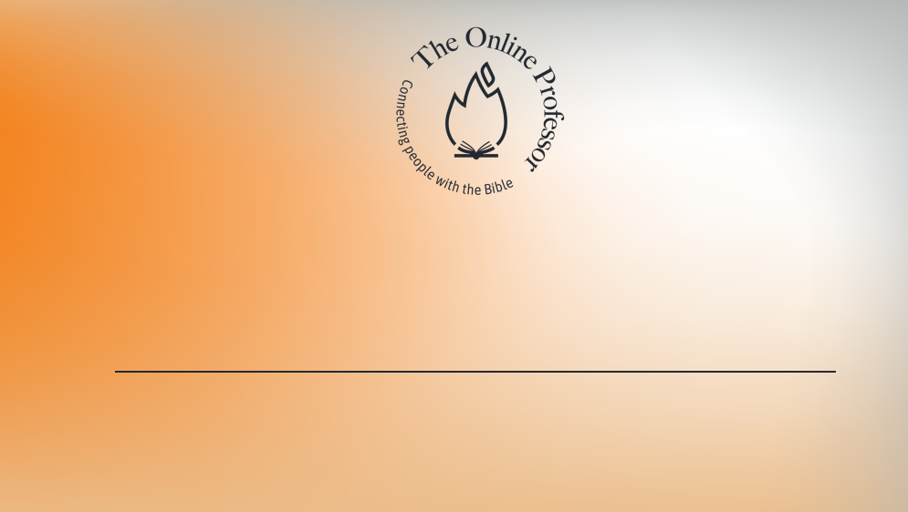
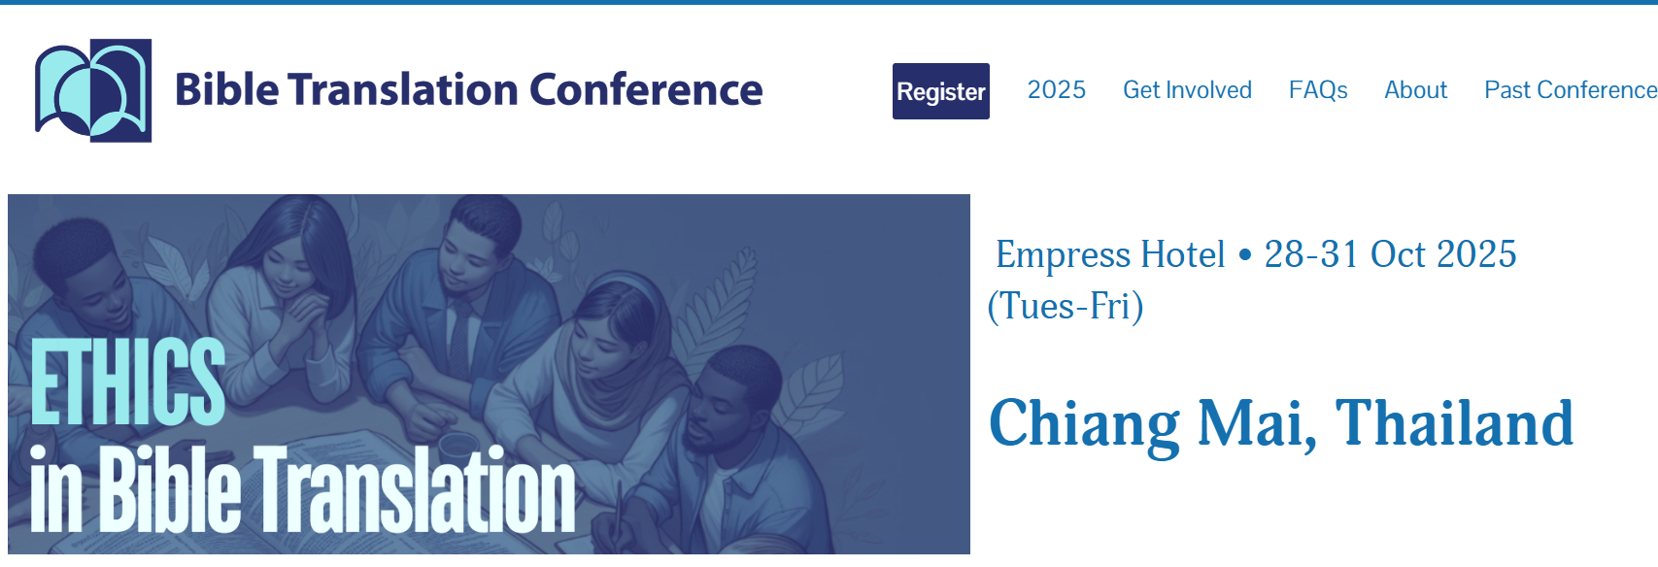
Persuasive Technology for Bible Translators
TheWell with BibleOL

Slide 2
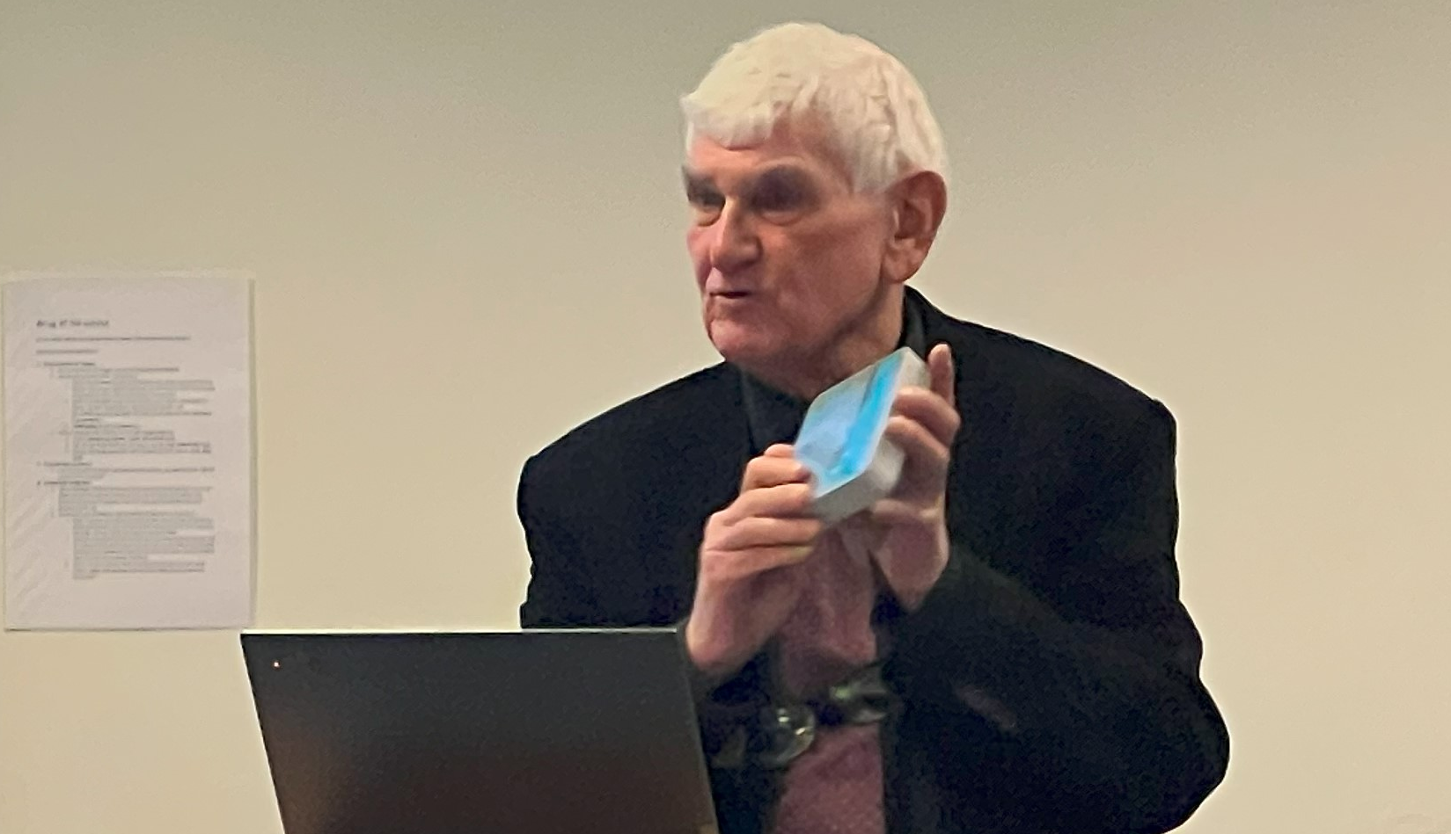
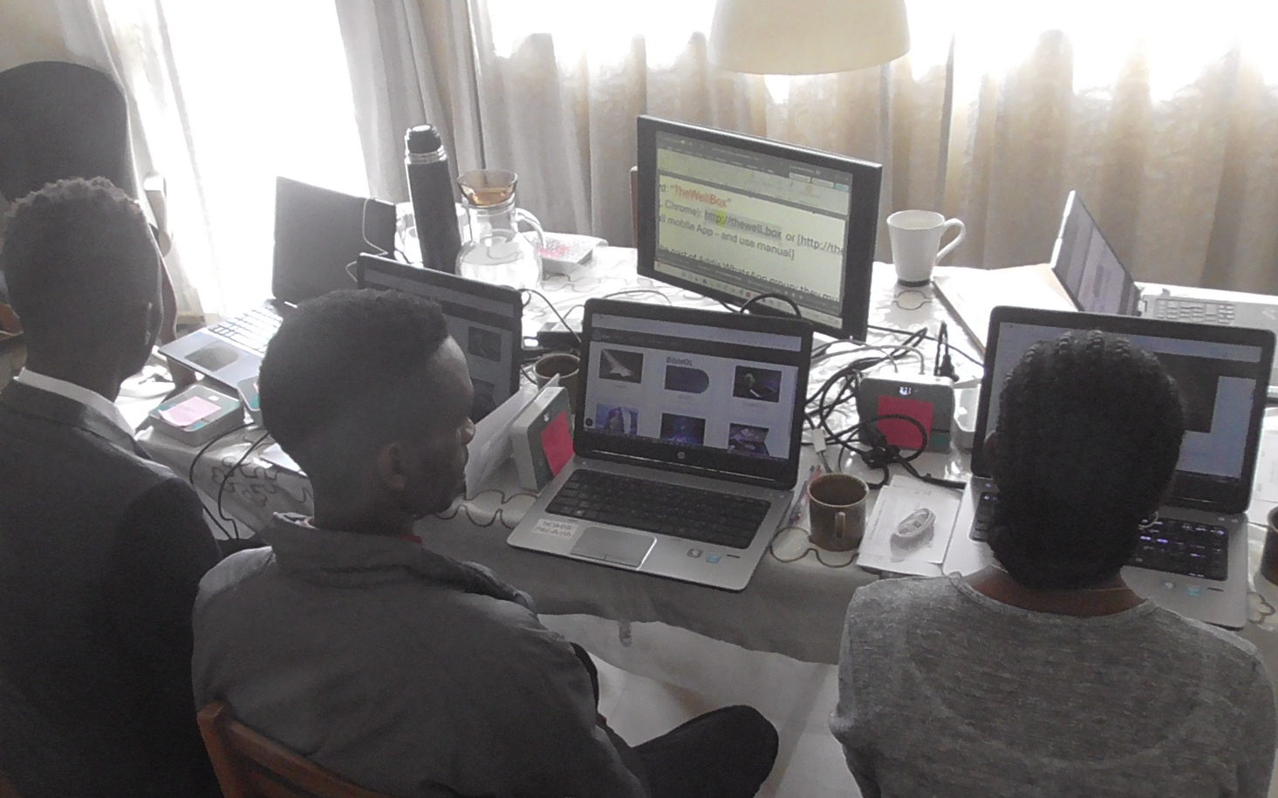
Part I: theory and design for persuasive learning
Part II: Ephrem Tariku
Persuasive evidence from Ethiopia
Nicolai Winther-Nielsen
BT Conference 2025

Slide 3

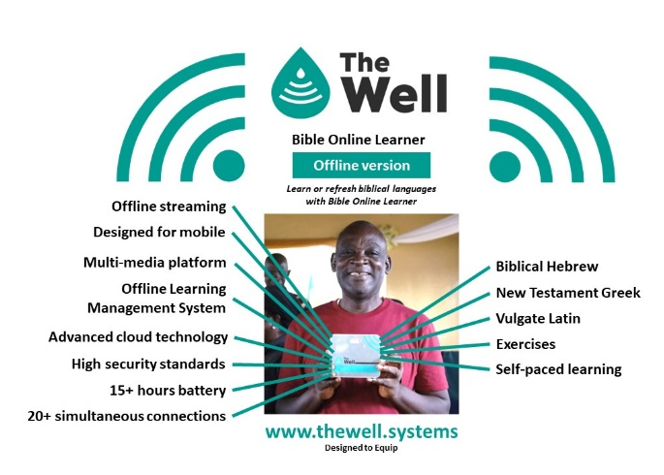
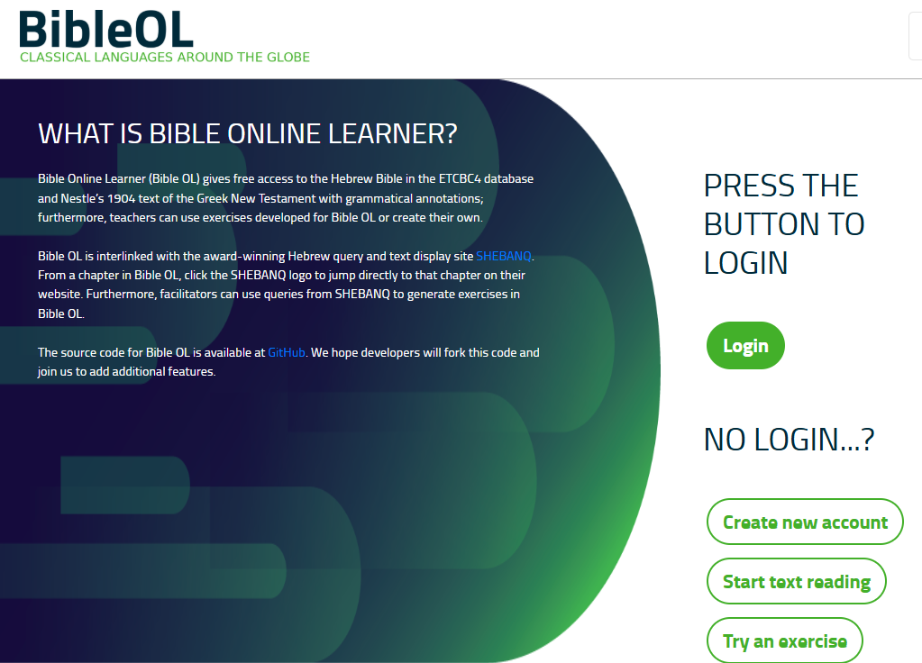
TheWell BibleOL

Slide 4
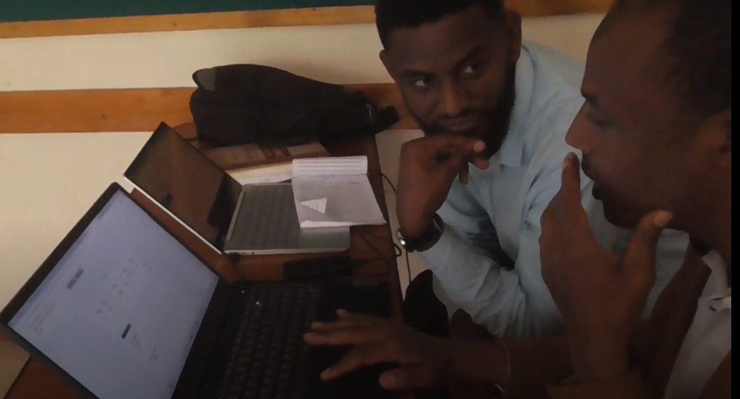
Outline
Part I: theory and design
  Persuasive technology as ethical design for learning
  Design for persuasive learning
  The PERSUADE framework
  Persuasive or not?
  Training for local instruction
TRAIN-THE-TRAINERS:
  how to persuasively train (in technology)
  the trainers (instructors as facilitators)
  to facilitate the trainees (learners )
ONLINE-OFFLINE SOLUTIONS:
  Bible Online Learner in a classroom
  TheWell for advisors and consultants
THE ETHICS OF A LEARNING TECHNOLOGY
  The global issues to address

Slide 5

DEFINITION
Definition
A responsible use of “interactive computing systems designed to change people’s attitude and behaviors” (Fogg, 1).
Technology can “proactively seek to motivate and influence users… It can encourage, provide incentives, and negotiate” (Fogg, 16)
B.J. Fogg (2003)
Change behaviour – in an ethical way

Slide 6
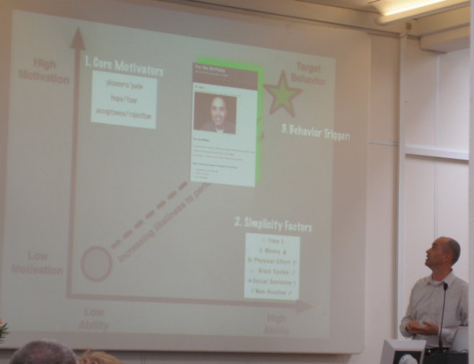
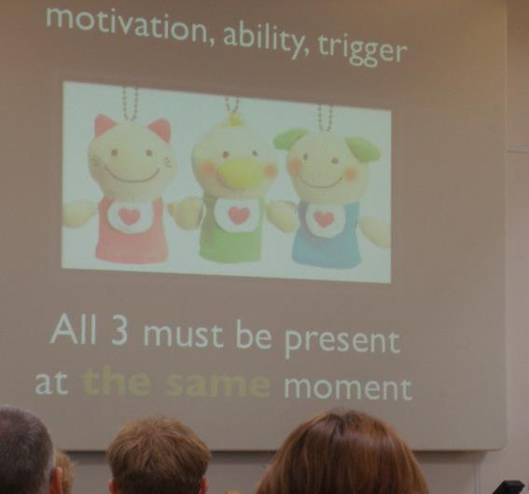
Target
Motivation, ability, trigger

Slide 7
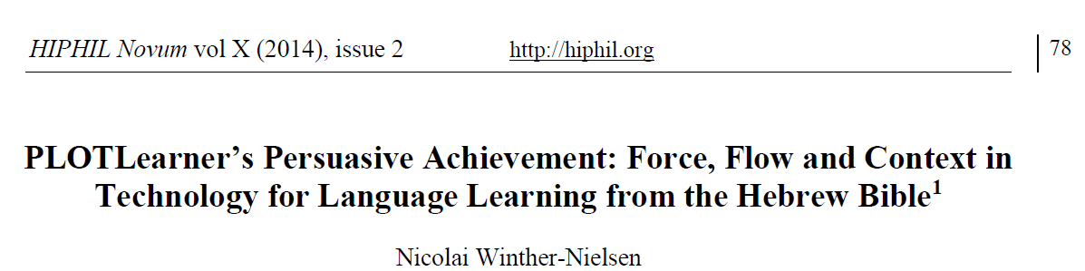
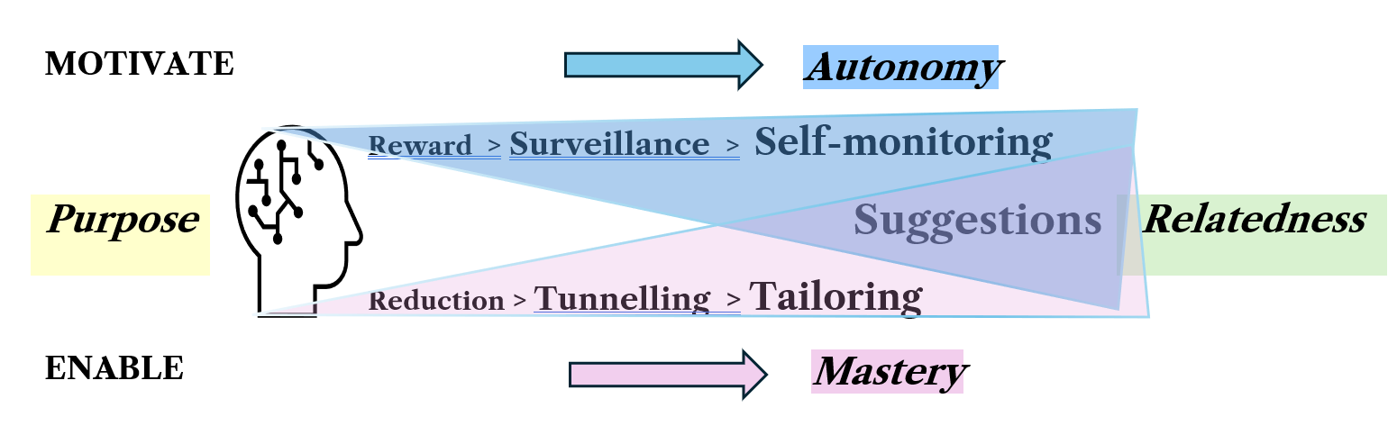
Launching RAMP
Relatedness Ability Mastery Purpose

Slide 8
RAMP contexts
Motivate: reward > surveillance > self-monitoring
Enable: reduction > tunneling > tailoring
SUGGESTION
Contexts
Learning Content
Learner engagement
Institutional setting
Social environment
Learner
Provider
Social world

Slide 9
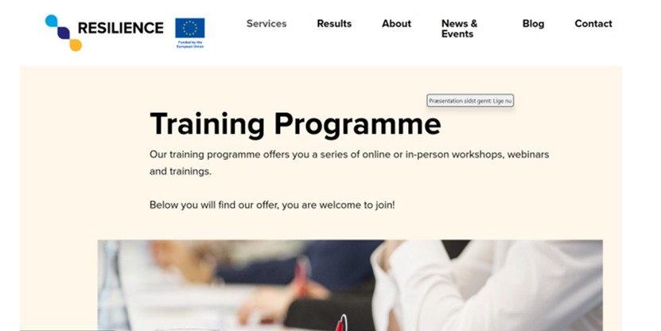
PERSUADE (2025)
New model to train-the-trainers
www.resilience-ri.eu/training-programme/

Slide 10
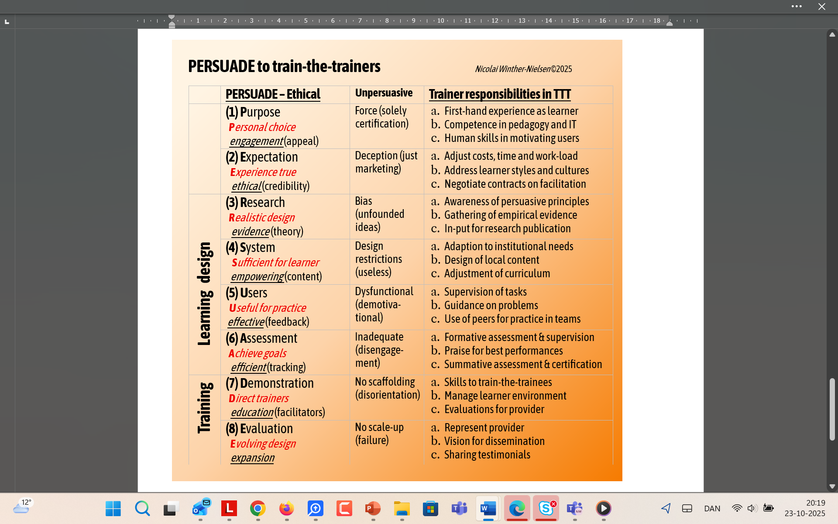
PERSUADE (2025)

Slide 11
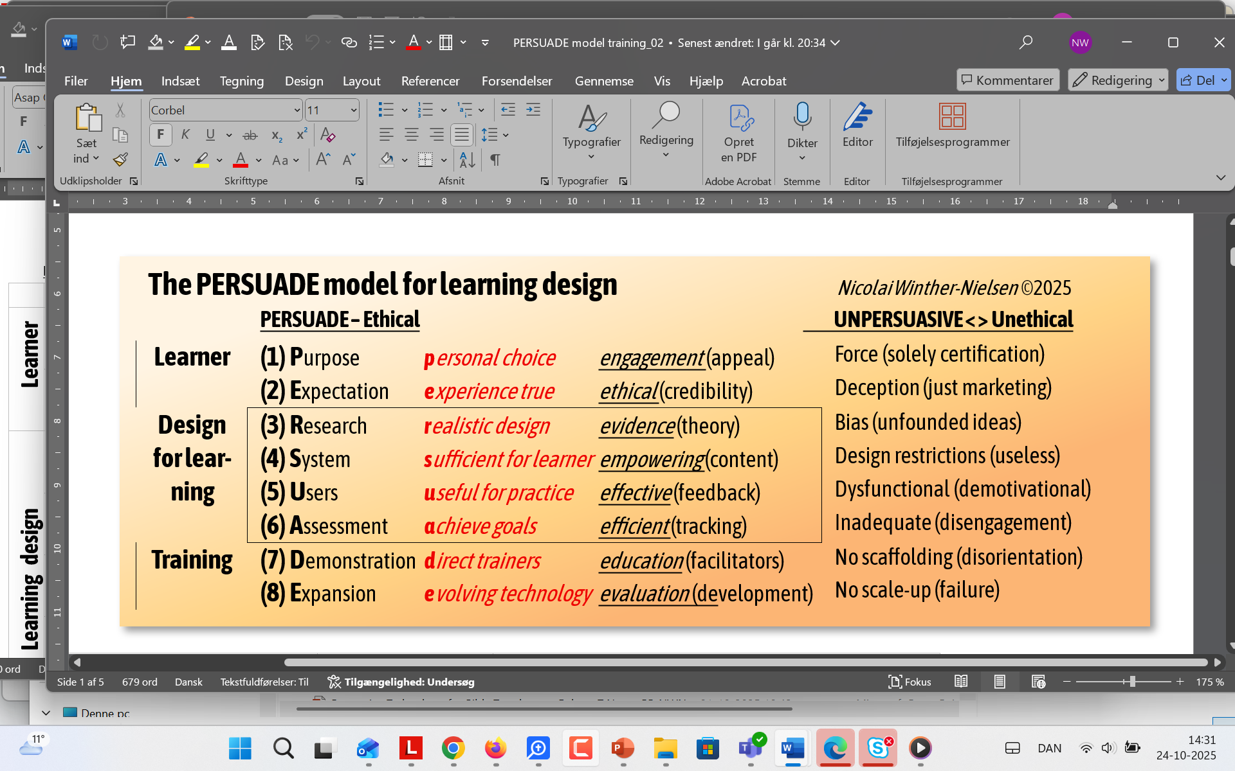
PERSUADE (2025)
Persuasive-ethical vs. Unpersuasive < > Unethical

Slide 12
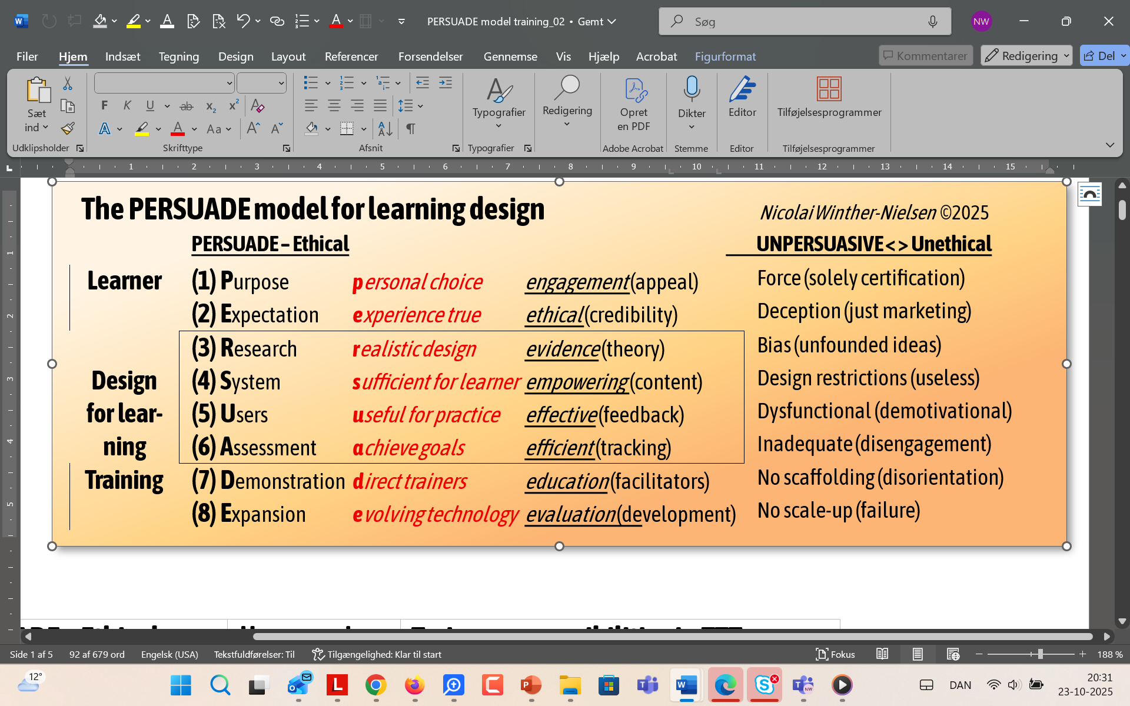
Learner ethics
Exams, deceptive marketing
Engage, true testimonials

Slide 13
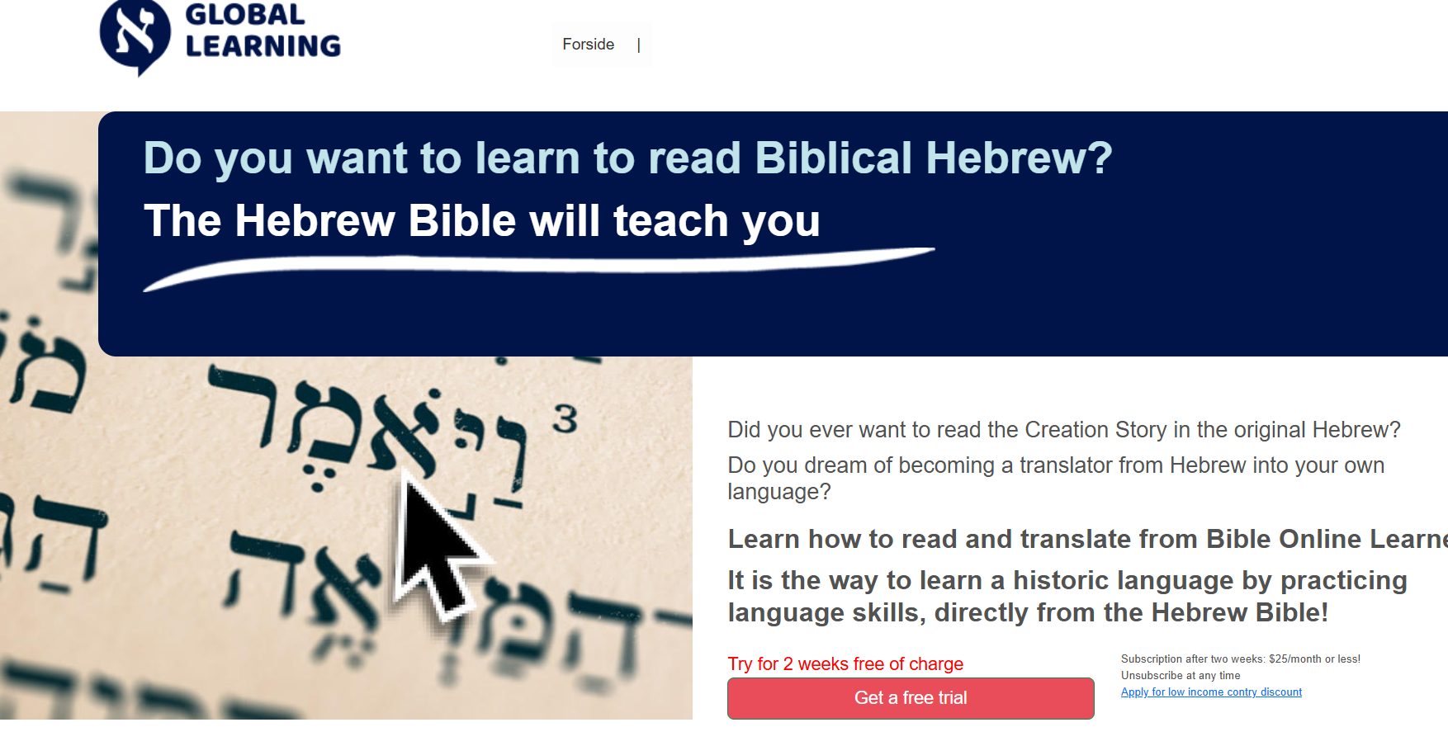
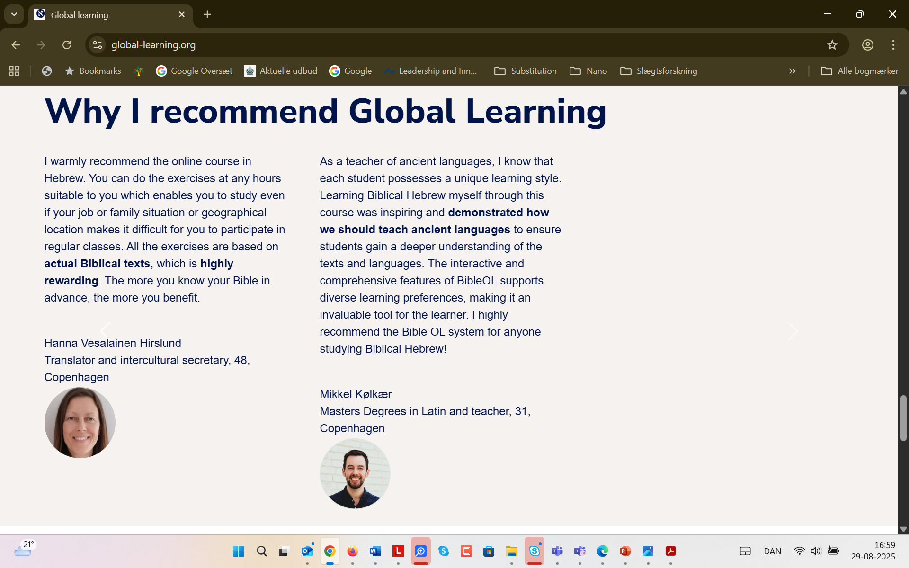
Learner ethics

Slide 14
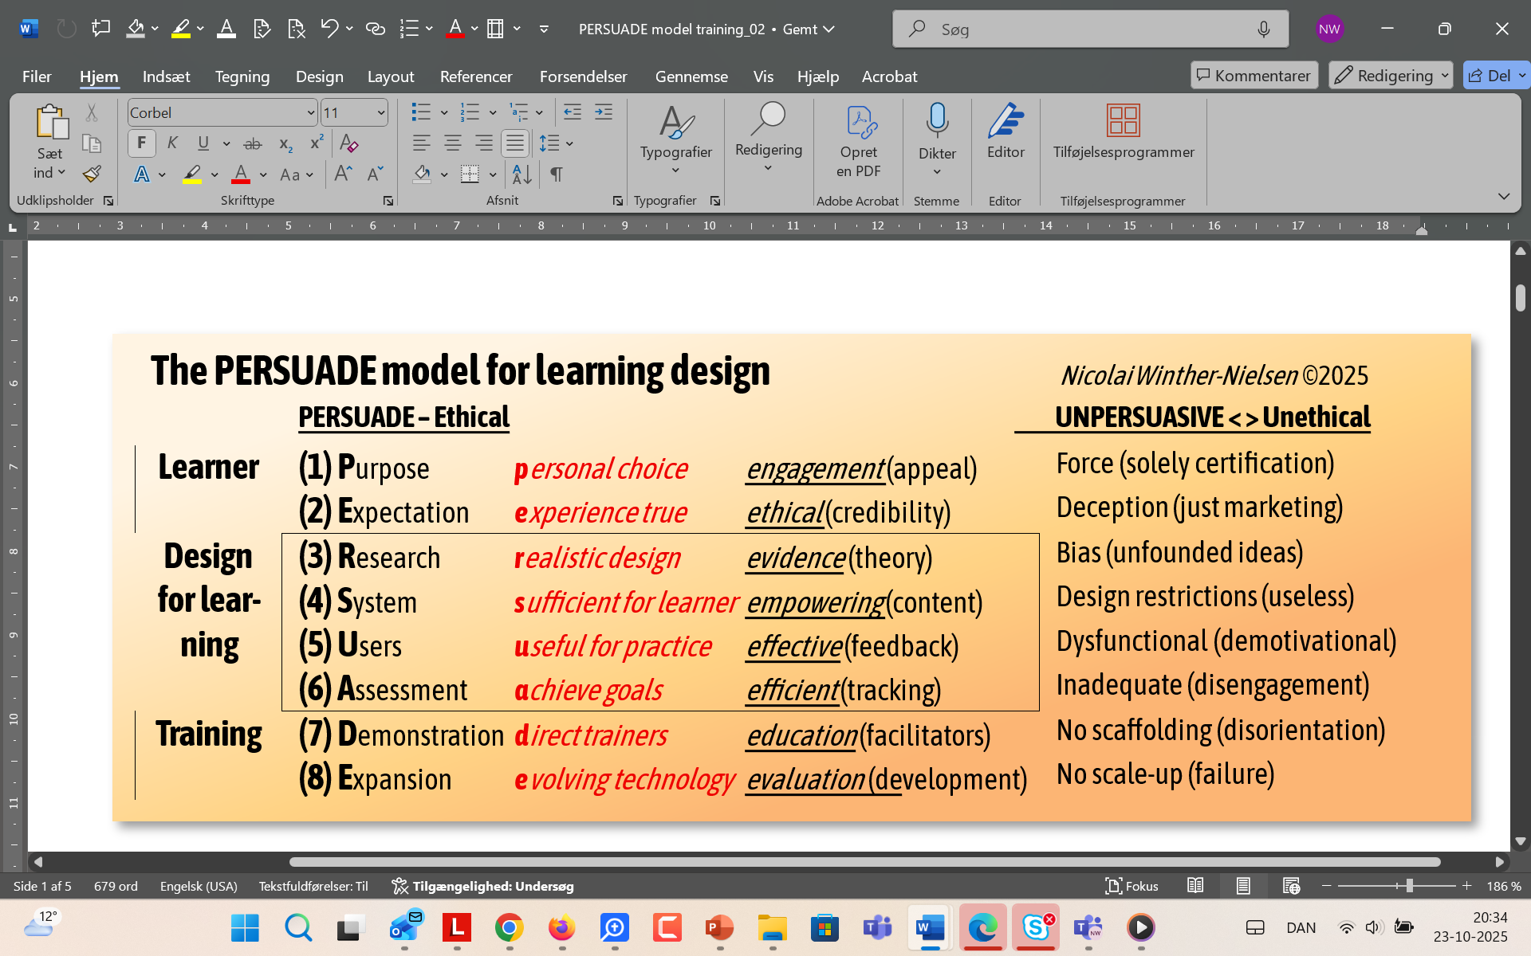
Design for learning
Assumptions, no testing
From 2008, EuroPLOT 2010-13, Nida Institute 2023-
System: Content adapted to tasks

Slide 15
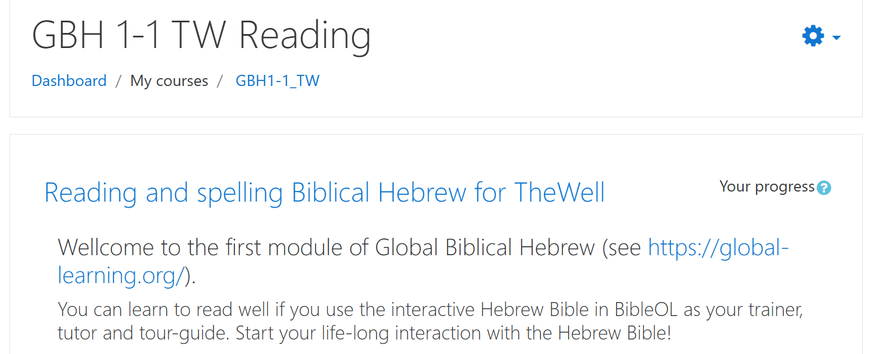
System
Moodle text and video as interface to BibleOL

Slide 16
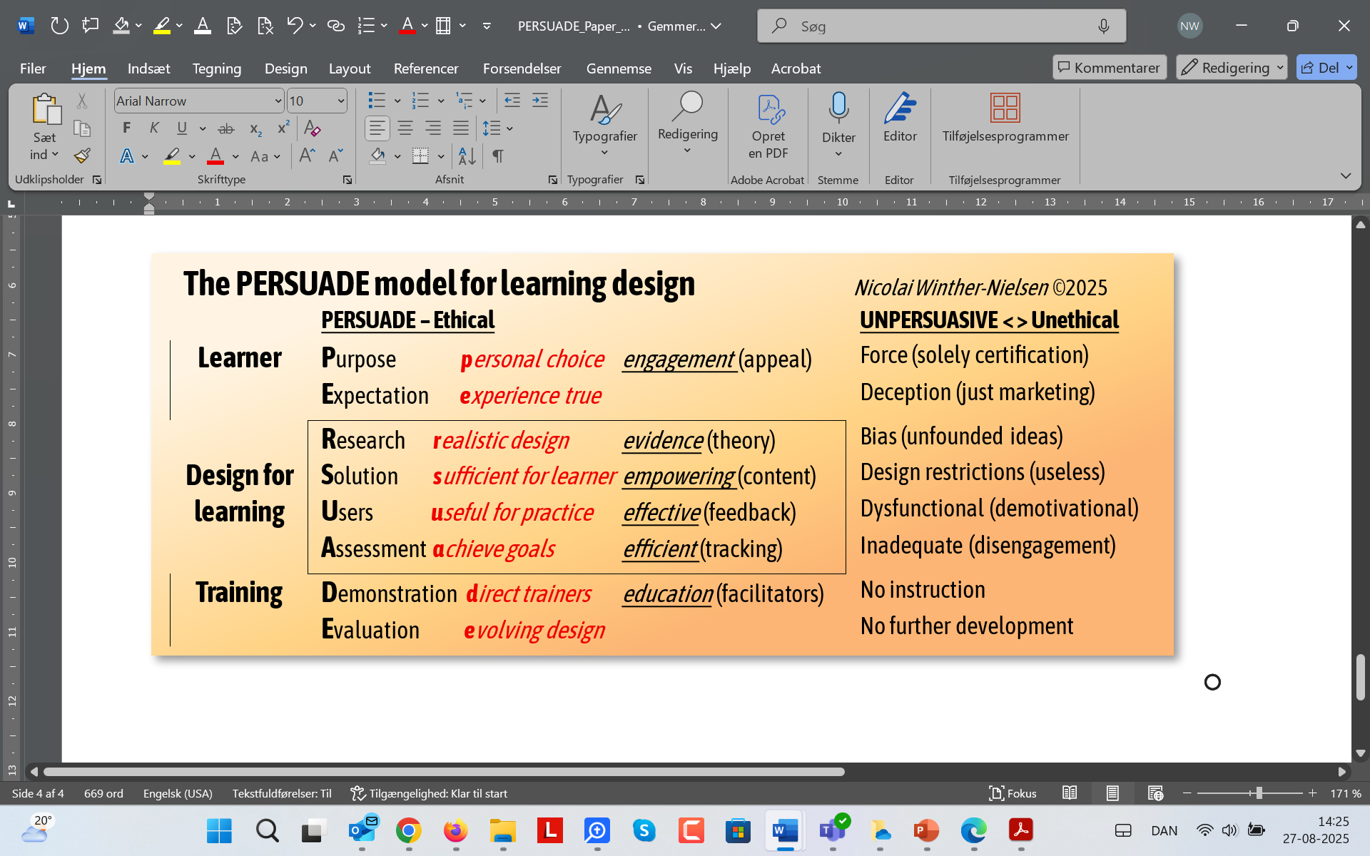
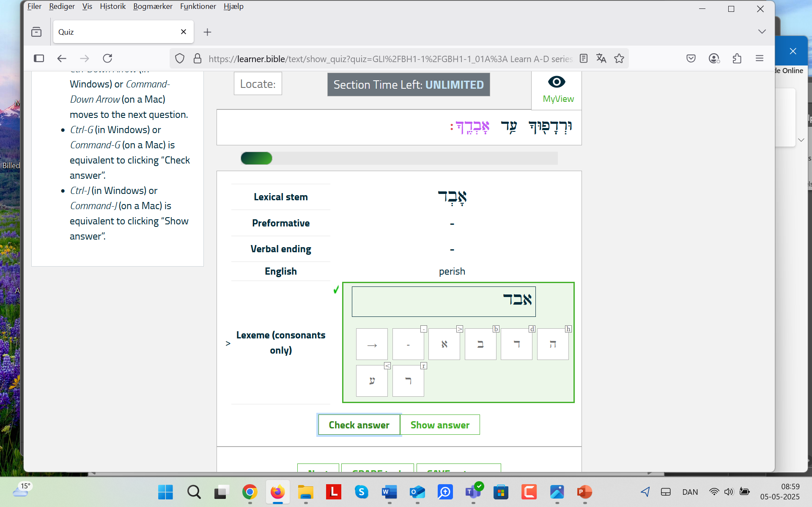
User
Practical learning (instant feedback)

Slide 17
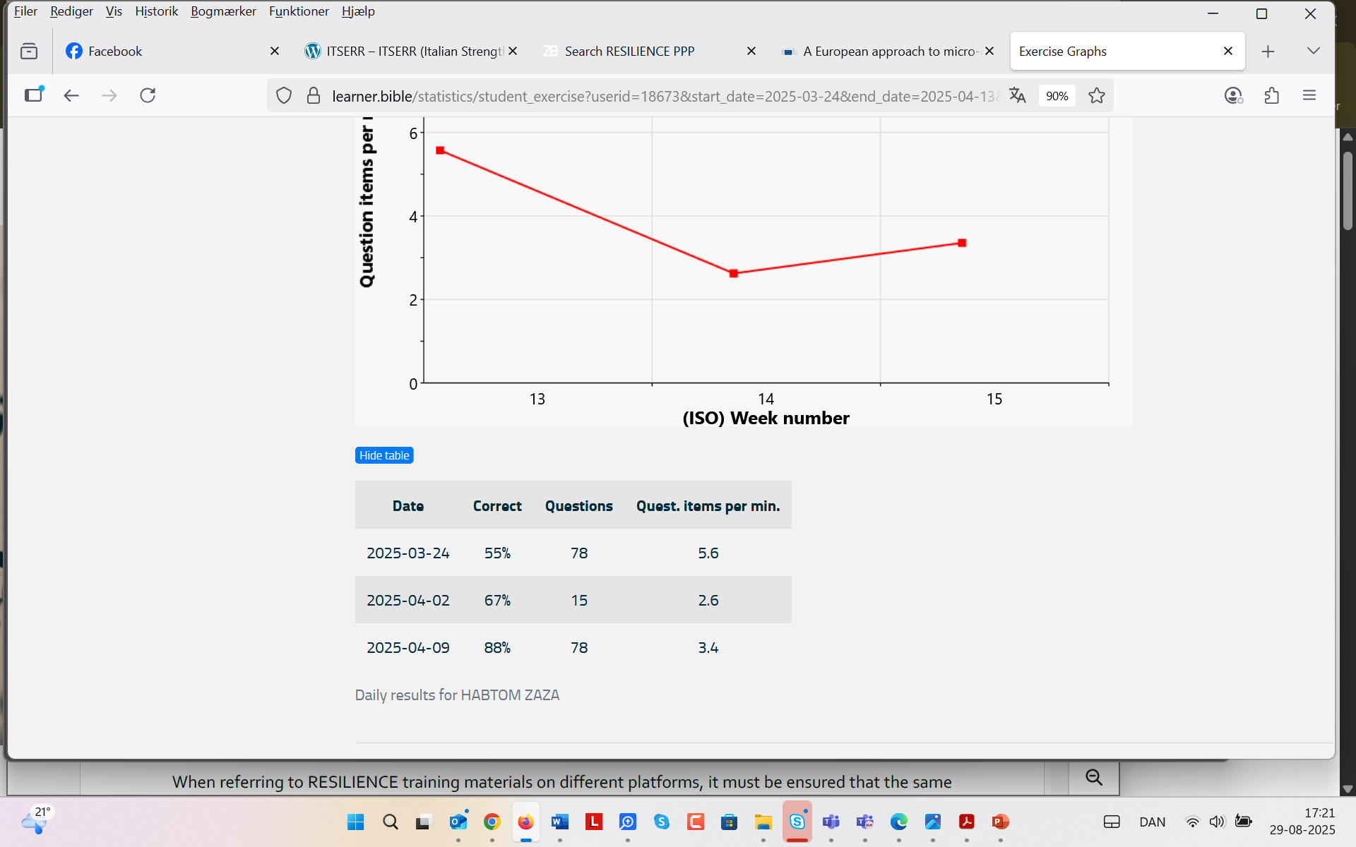
Assessment
Performance tracking

Slide 18
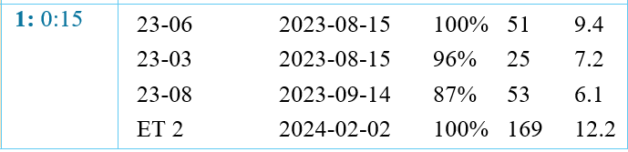
Proficiency
Answers per minute (at a reasonable speed)
Number of questions (in many cases)
Percentage correct (complete mastery)

Slide 19

Training
Need for training, demonstration and direction
Expansion, evaluation

Slide 20
Training design
Training Delivery Agreement Clause
The training provider agrees to design and deliver courses:
Practical Focus: emphasize practical application of tools and concepts over technical or theoretical detail, unless such content is essential for understanding or explicitly requested.
Participant Engagement: Participants must be given structured opportunities to independently apply the tools after a guided introduction, followed by expert-led discussions of their results.
Course Structure: Training sessions should be modular, practical, and manageable
Pre-Course Coordination: Clear communication to align expectations and agree on lesson plan.
Transparency: clearly communicated to participants in advance.
Guideline Compliance: “RESILIENCE Key Recommendations for Training Design and Delivery”
www.resilience-ri.eu/training-programme/

Slide 21
Summary
To be trained by the Hebrew Bible!
P Easy to start: engage
E Fun to use: gaming, exploring
R Repurpose locally: 15 years development
S Online/Offline system: global potential
U Effective: practice is foolproof –top results
A Efficient: Self-directed mastery
D Train-the-trainers: Local instruction
E Go global: https://theonlineprofessor.org/thewell/

Slide 22
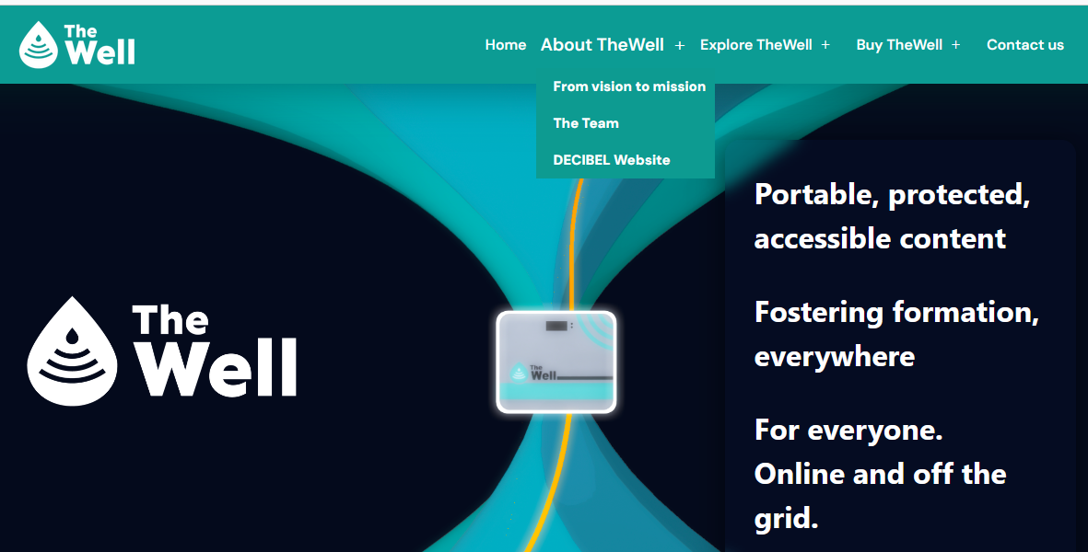
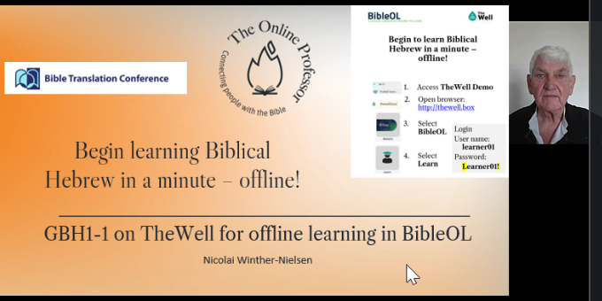
Part II coming up
Access TheWell and learn in minutes: videolink

Slide 24
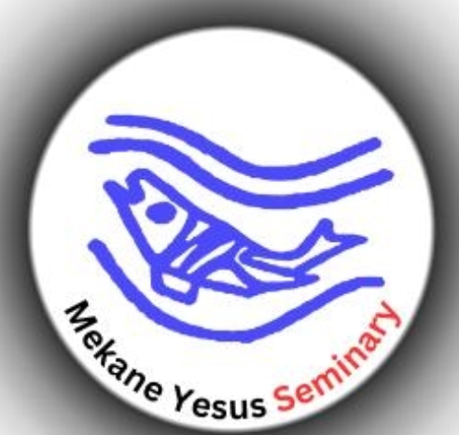
Persuasive evidence from Ethiopia: TheWell with BibleOL
Based on qualitative analysis from learners

Slide 25
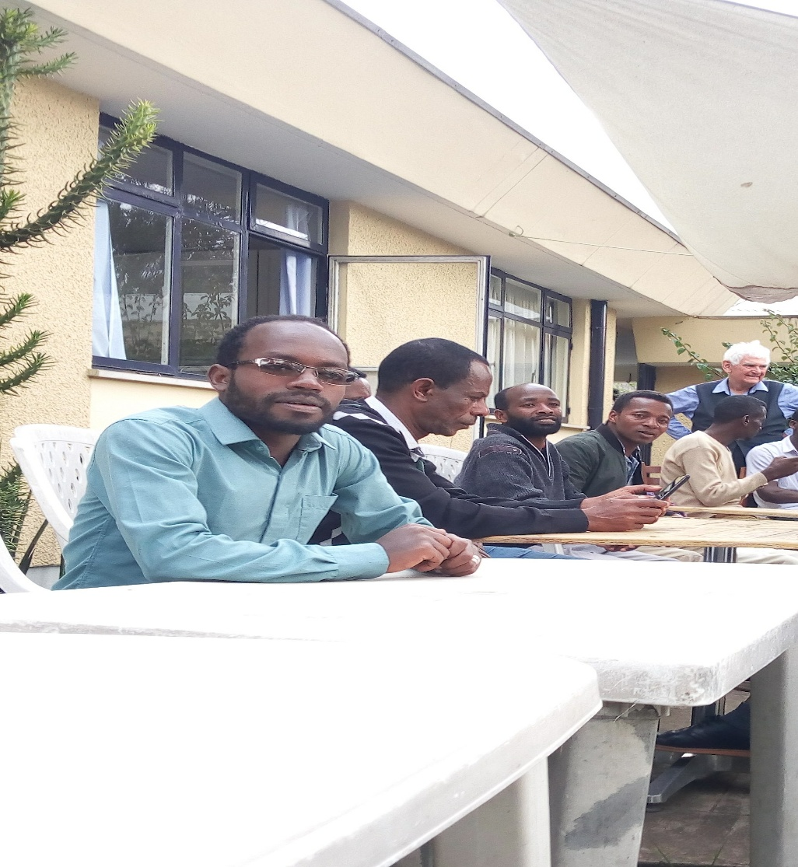
BibleOL
Has the potential to enhance: self-pace (learning on your own when and wherever you want)
It allows learners to learn by going through practice (it is possible to practice several exercises online/offline)
Has gamification (competition that encourages the learners to work on several exercises)

Slide 26
I was one of the students in the BibleOL class at the Mekane Yesus Seminary (MYS) in 2019, and I benefited a lot from the program.
https://promissio.dk/foelg-med/nyheder/hebraeisk-paa-seminariet/
Takele Kebede (Instructor at MYS)
Takele is a beginner in the BibleOL (trainee of Habtom). He is excited and committed to deepen his knowledge of biblical languages so that he may enhance his exegetical skills – sound doctrine (a systematic department professor).
Also, he recommends the program for his colleagues at the seminary.

Slide 27
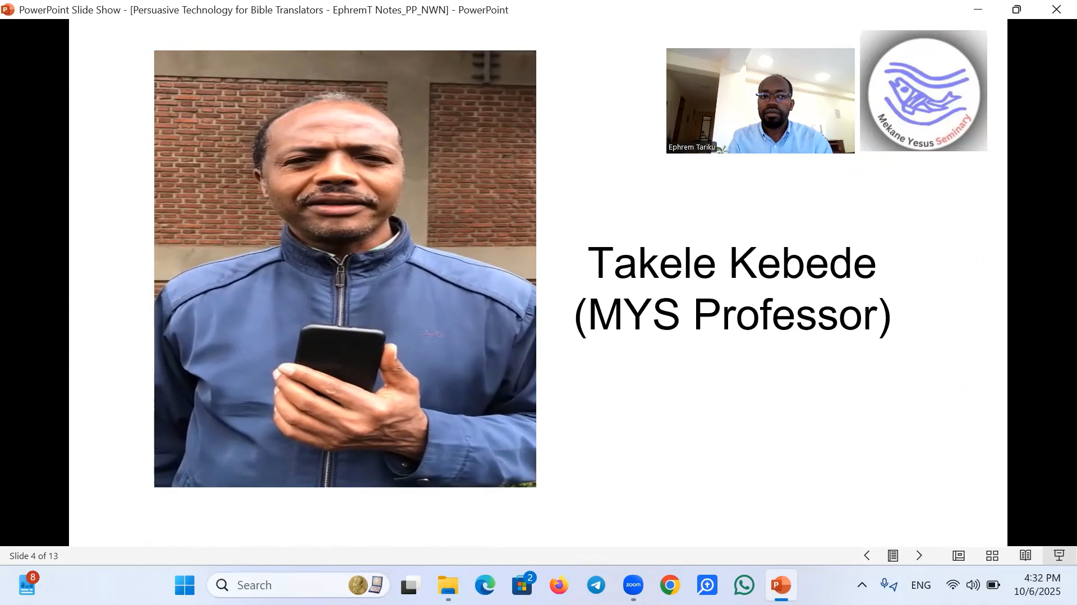
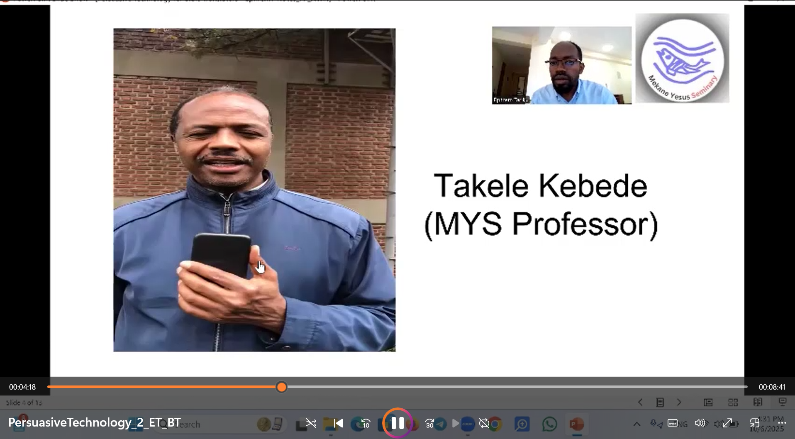

Slide 28
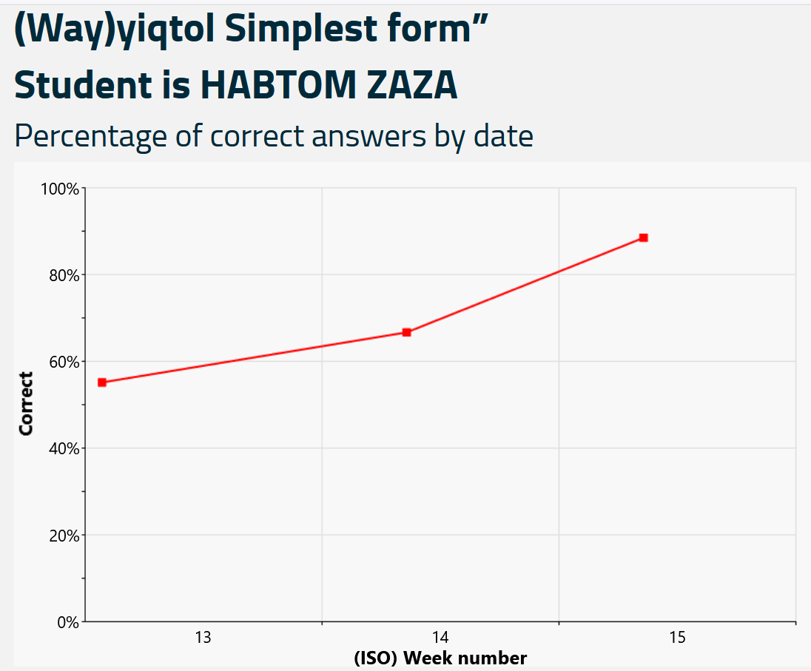
BibleOL
Habtom Zaza (Student at ETC)
Witnesses that, “After starting learning Biblical Hebrew through the BibleOL, … I learned to read and write Hebrew. Now I am learning at an advanced level.”

Slide 29
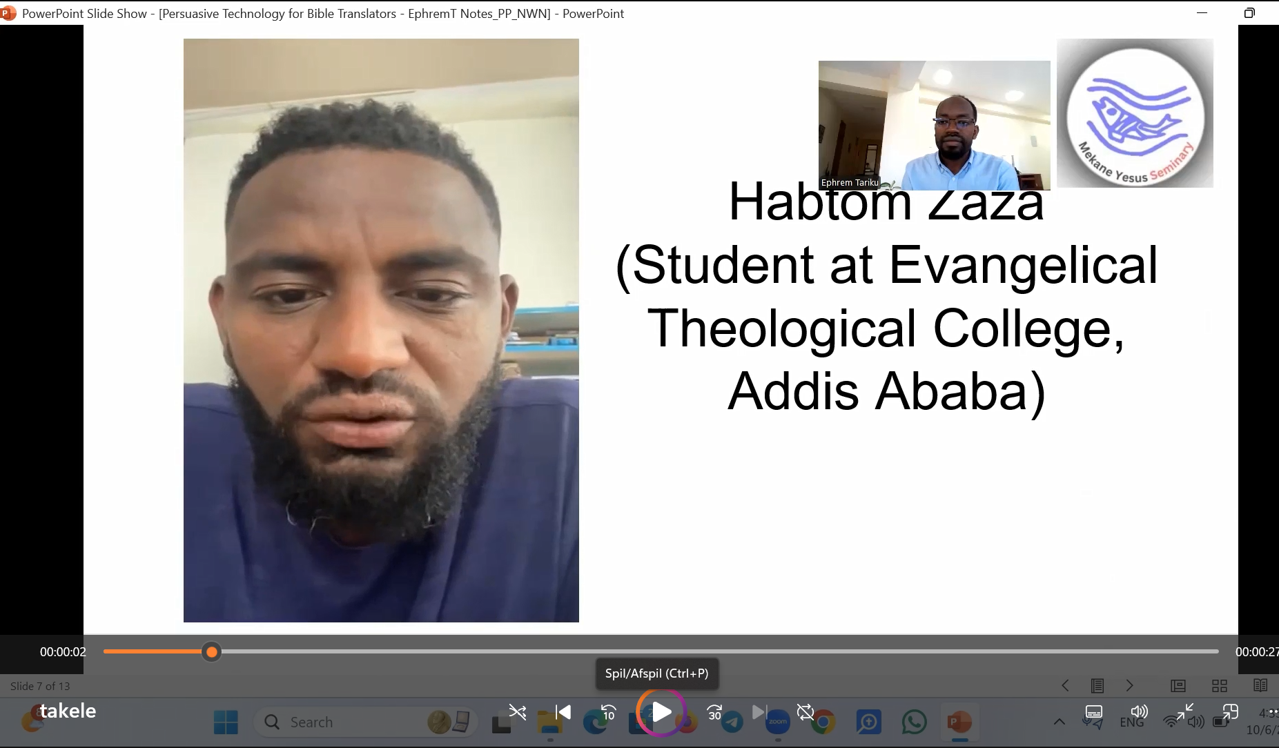
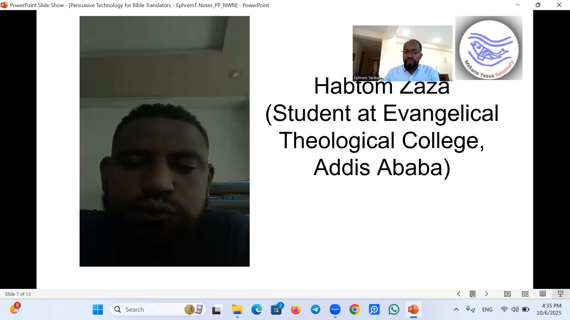

Slide 30
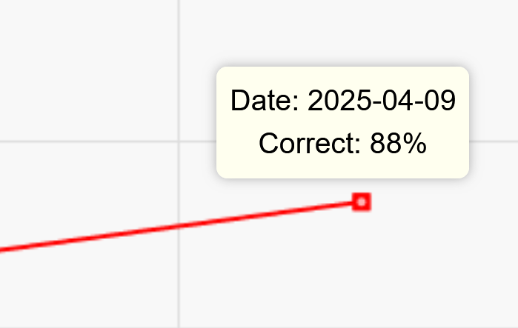
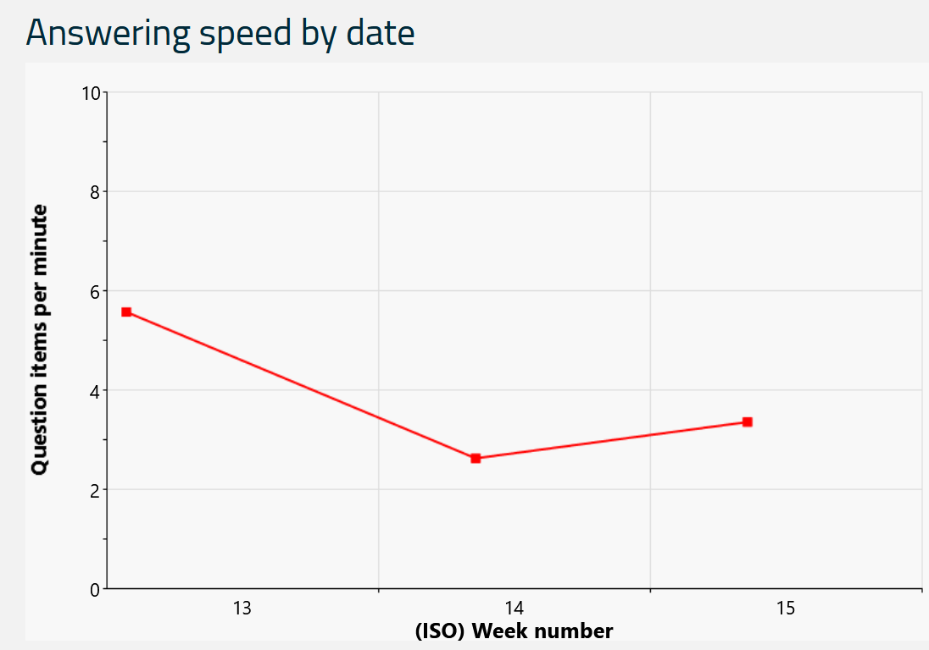
Efficient performance
Formative assessment (performance tracking)

Slide 31
TheWell Box
Can be useful in a context like Ethiopia (electricity and internet are issues)
Especially beneficial for learners and Bible translators, this could advance their knowledge in biblical Hebrew to do a sound exegesis (very crucial for accurate translation and sound teaching).
TheWell box has the potential to train trainers (instructors) who can assist others to learn.
A learner could be anyone interested, committed learn and advance his/her biblical Hebrew proficiency (starting from beginner)
The Well has the potential to work in very remote areas for a significant amount of time once charged (16 hours).

Slide 32
TheWell
Habtom
“When the power goes (the internet also goes/unstable) … After getting TheWell box, the problem has been solved. You can easily move TheWell with you, and you can keep practicing as long as the box is with you.”
“It is beneficial in contexts like Ethiopia, Africa, where electricity and internet are an issue.”
Helps you to use your time effectively, “I sometimes practice the exercise even in transportation.”

Slide 33
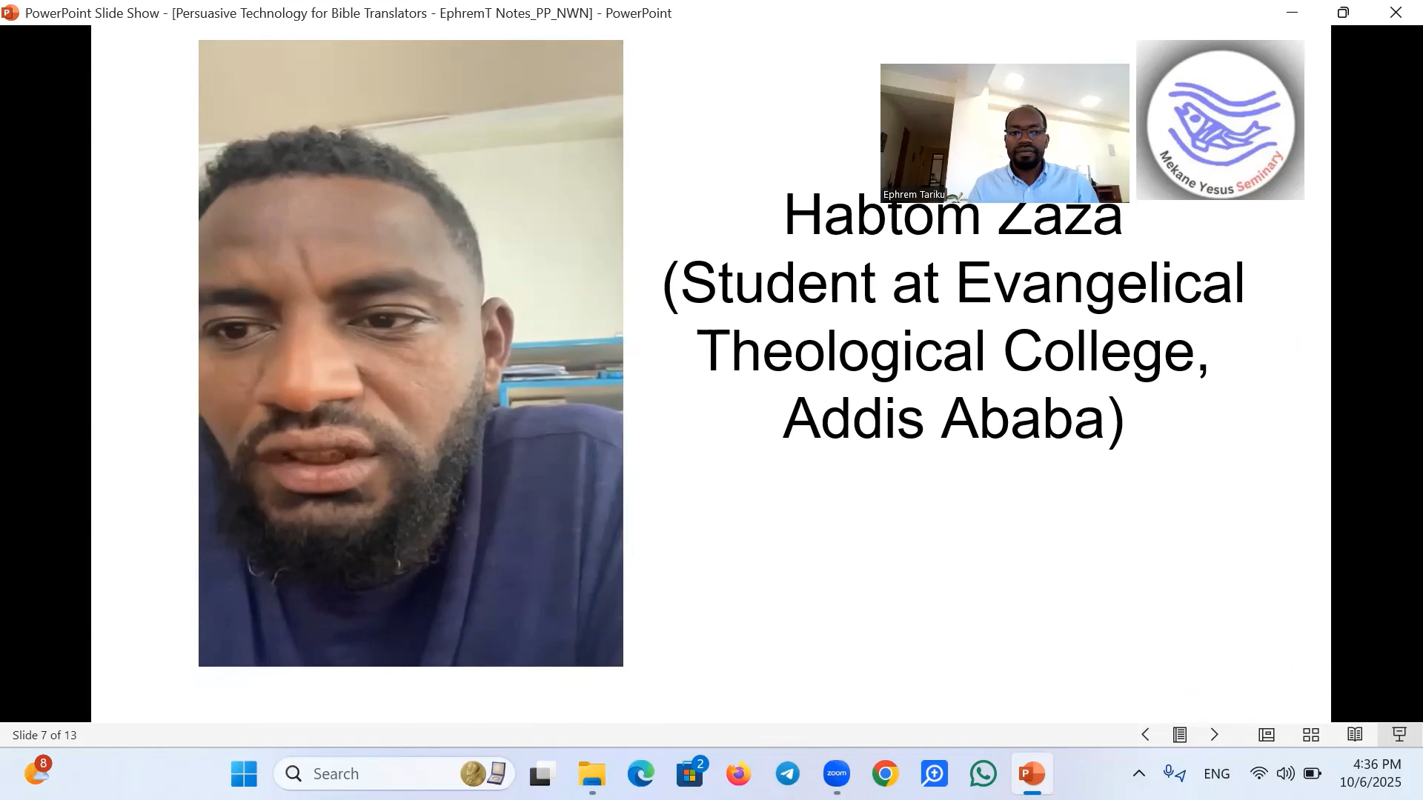

Slide 34

A private student who lives and works about 600 km away from Addis Ababa, the capital of Ethiopia, witnesses that TheWell helped him to continue learning in a rural town.

Slide 35
“I had an ambition to learn Biblical Hebrew online, but the internet connection and shortage of electricity were the major problems for me in my local area. But now I could learn Biblical Hebrew online without an internet connection (offline), using a device called TheWellBox.
I have learned and finished the intermediate level by using the WellBox device, and I could improve my skill in Hebrew without worrying about the internet connection problem. So, I appreciate those who are willing to join and learn Biblical Hebrew online, especially in areas like mine where the WellBox system is the best solution.”

Slide 36
BibleOL at the local level, Addis
1) Trian trainers
- Sustainability
- Local ownership
(Training instructors – interested and committed to go through the process. The trained instructors will supervise learners in their engagement/involvement in this process (the BibleOL) – at various levels (beginner, intermediate, and advanced)
Biblical students, theologians, and Bible translators, translation advisors, and translation consultants – ongoing training.
2) Ethical learning
Technology for language learning – ensuring ethical use of the technology
3) The Wellbox
Online/Offline solution for contexts like Ethiopia

Slide 37
BibleOL at the local level, Addis
The Well Center
IT Room (A place where learns practice and collaborate with other learners, intensive courses for beginners).
It’s the potential to be used in a context like Ethiopia.
In conclusion, TheWell with BibleOL has a great potential to advance biblical languages training for theologies, pastors, and Bible translators. (We are discussing beginning the training for trainers at the seminary. This, we believe, would benefit our students to deepen their knowledge and skill in biblical languages/Hebrew to ensure sound exegesis and quality translation.

Slide 38
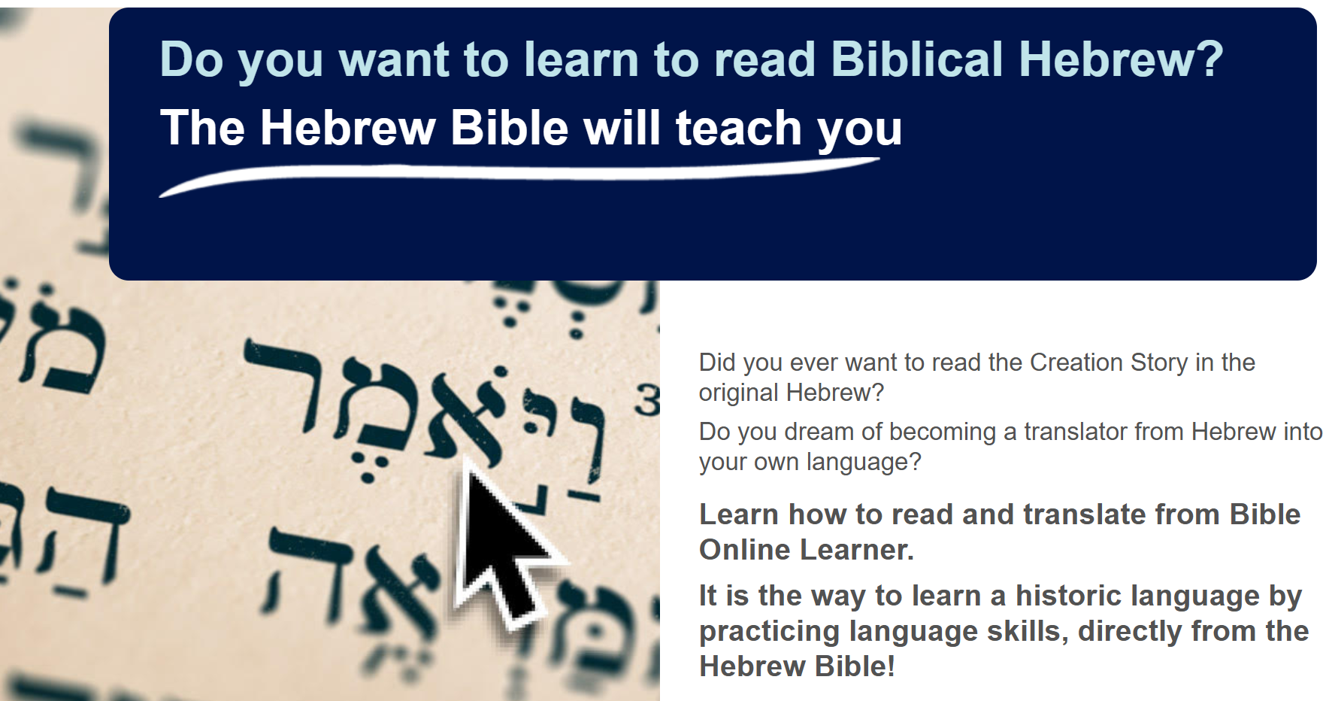
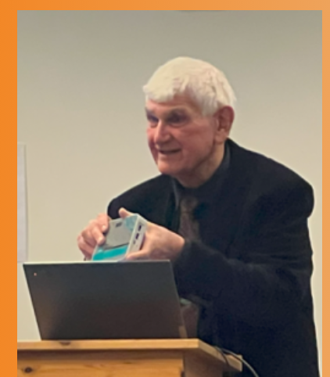
Thank you – try it out!

